Slide 1
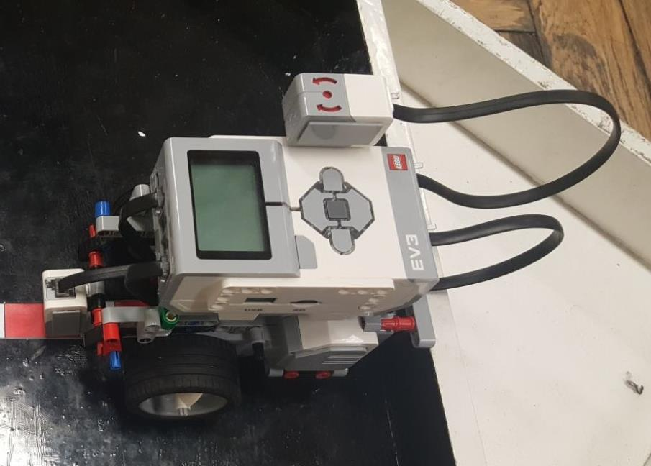
Hardware Design
Robot Dimensions:
Notes:
Hardware Design
Dimensions: 12 cm by 19 cm
Sensors attached – GyroSensor and Color Sensor
We designed the robot to be as compact as possible to navigate small spaces
At the same time we wanted our robot to do tight turns so we didn’t raise the block

Slide 2
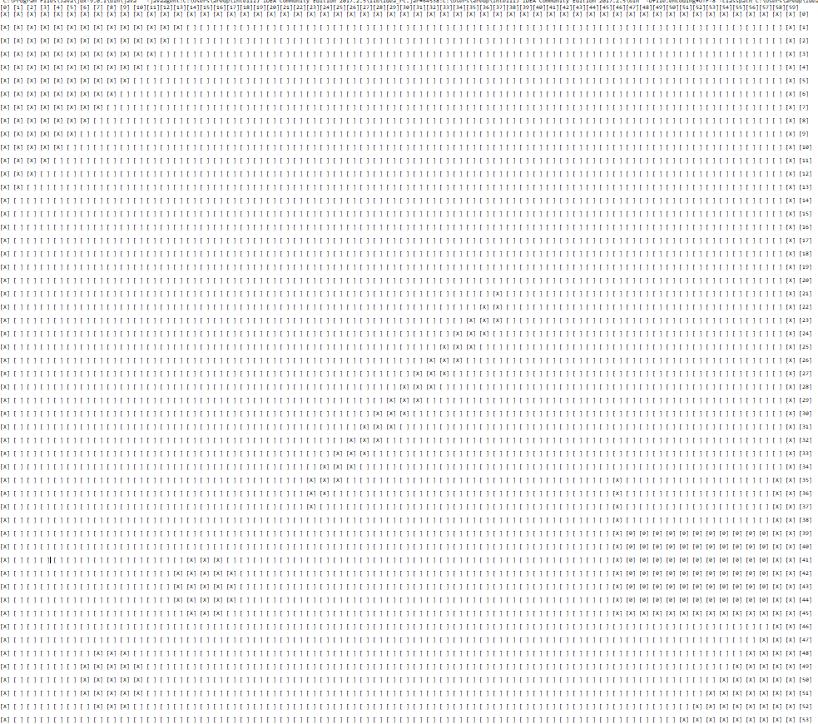
Notes:
Map
How we decided the dimensions of the map vs real dimensions of the arena
Explain code implementation of the map (which objects are hard coded in)
Explain how the map implements the obstacles that are given on the day of the exam
Explain how the map interacts with the rest of the code

Slide 3
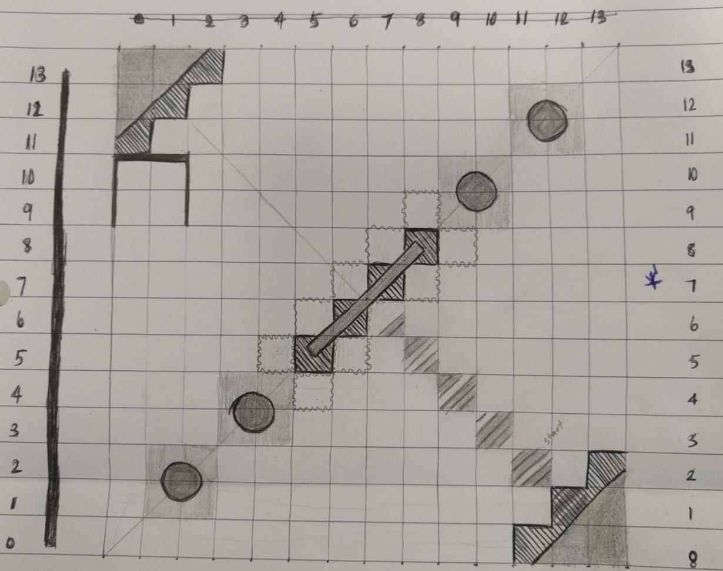
Notes:
Localization Slide

Slide 4
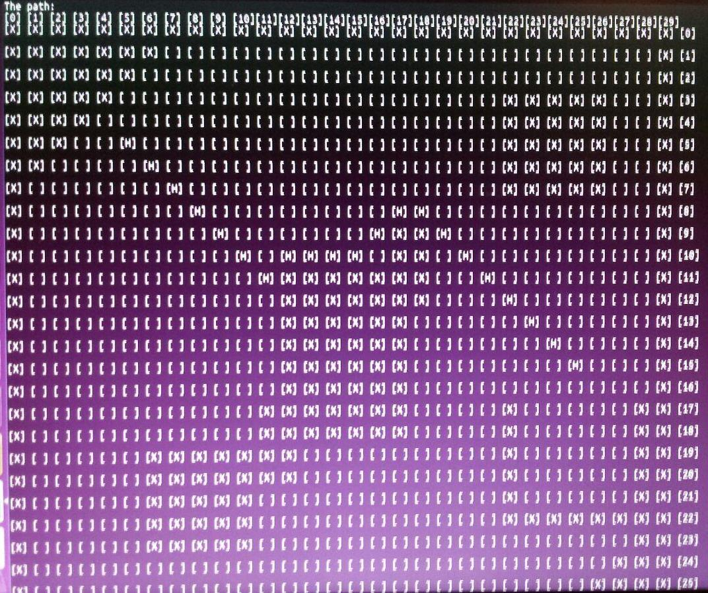
Notes:
Box Map implementation and background of Astar
Explain how the Box Map relates to the Map and why we need the conversion to Box Map
Explain what a cell is and its function
Explain why the objects have been thickened in the box map as opposed to the map
Explain that the box map was also used in debugging the Astar algorithm as it provided a visual insight on the path the robot takes

Slide 5
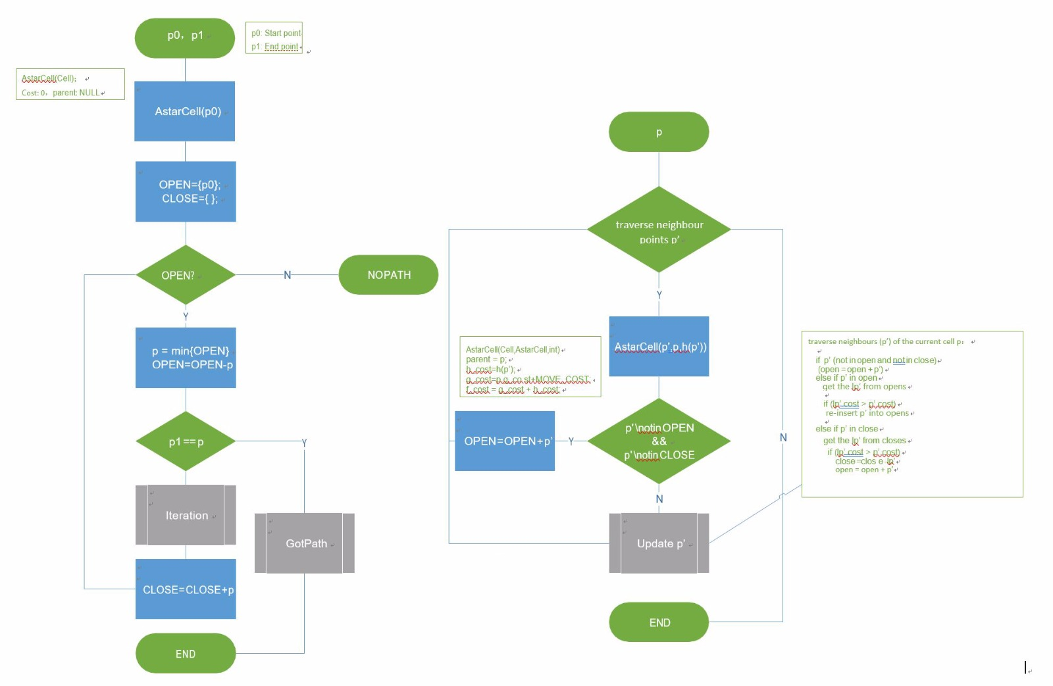
Notes:
Astar Algorithm
Explain the Astar Algorithm (how the Algorithm deals with obstacles, how distance is treated)
Explain how the Astar algorithm interacts with the boxmap

Slide 6
Team Management
Hardware Design – Shu & Ashley
Initial Gyrosensor testing - All members
Map design – Andrei
Localization – Eric
Astar Algorithm and BoxMap Implementation – Shu & Ashley
Differential Drive – Andrei & Eric

Slide 7
Additional Improvements
Improve Astar algorithm to avoid thickening of obstacles on BoxMap
Wire placement

